Slide 1
Redux
A Predictable State Container for JS Apps
What is Redux?
Redux is a pattern and library for managing and updating application state, using events called "actions". It serves as a centralized store for state that needs to be used across your entire application, with rules ensuring that the state can only be updated in a predictable fashion.
Why Should I Use Redux?
Redux helps you manage "global" state - state that is needed across many parts of your application.
The patterns and tools provided by Redux make it easier to understand when, where, why, and how the state in your application is being updated, and how your application logic will behave when those changes occur. Redux guides you towards writing code that is predictable and testable, which helps give you confidence that your application will work as expected.

Slide 2
Properties of Redux
Predictable
Redux helps you write applications that behave consistently, run in different environments (client, server, and native), and are easy to test.
Centralized
Centralizing your application's state and logic enables powerful capabilities like undo/redo, state persistence, and much more.
Debuggable
The Redux DevTools make it easy to trace when, where, why, and how your application's state changed. Redux's architecture lets you log changes, use "time-travel debugging", and even send complete error reports to a server.
Flexible
Redux works with any UI layer, and has a large ecosystem of addons to fit your needs.

Slide 3
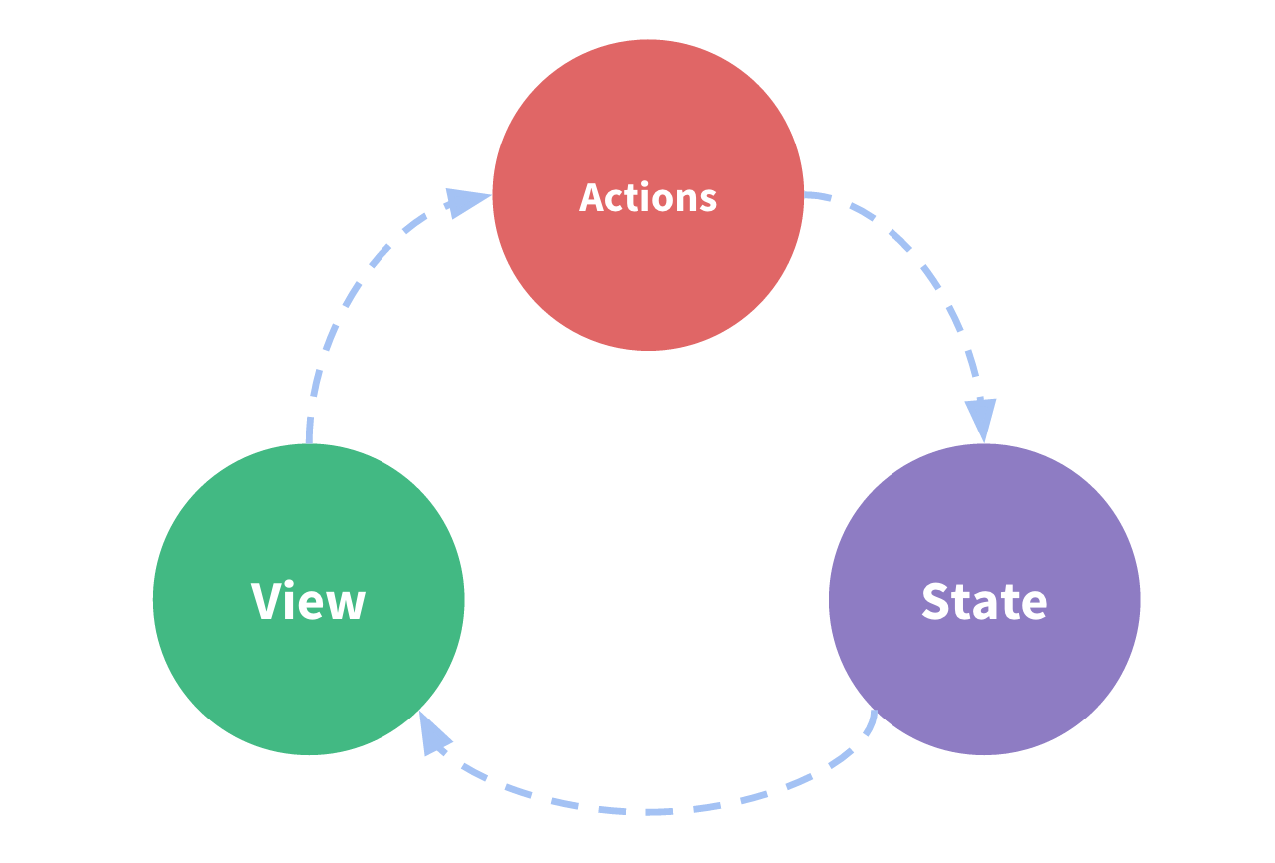
Redux Terms and Concepts
It is a self-contained app with the following parts:
The state, the source of truth that drives our app;
The view, a declarative description of the UI based on the current state
The actions, the events that occur in the app based on user input, and trigger updates in the state

Slide 4

Redux Example

Slide 5
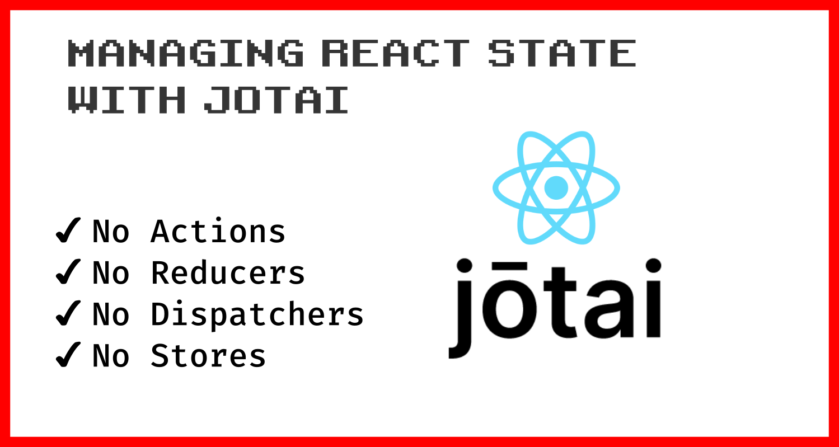
Redux-Free State Management with Jotai
What is jotai?
Primitive and flexible state management for React
No extra re-renders, state resides within React, you get full benefits from suspense and concurrent mode.
Its scalable from a single React. useState replacement up to large application with complex requirements
Jotai is a state management library for React that will save you from boilerplate tears with its minimalistic API. And yes, you don’t need to create any actions, reducers, or dispatchers when using Jotai!
The mechanics of Jotai, is very similar to React Context and Recoil, is very simple.

Slide 6
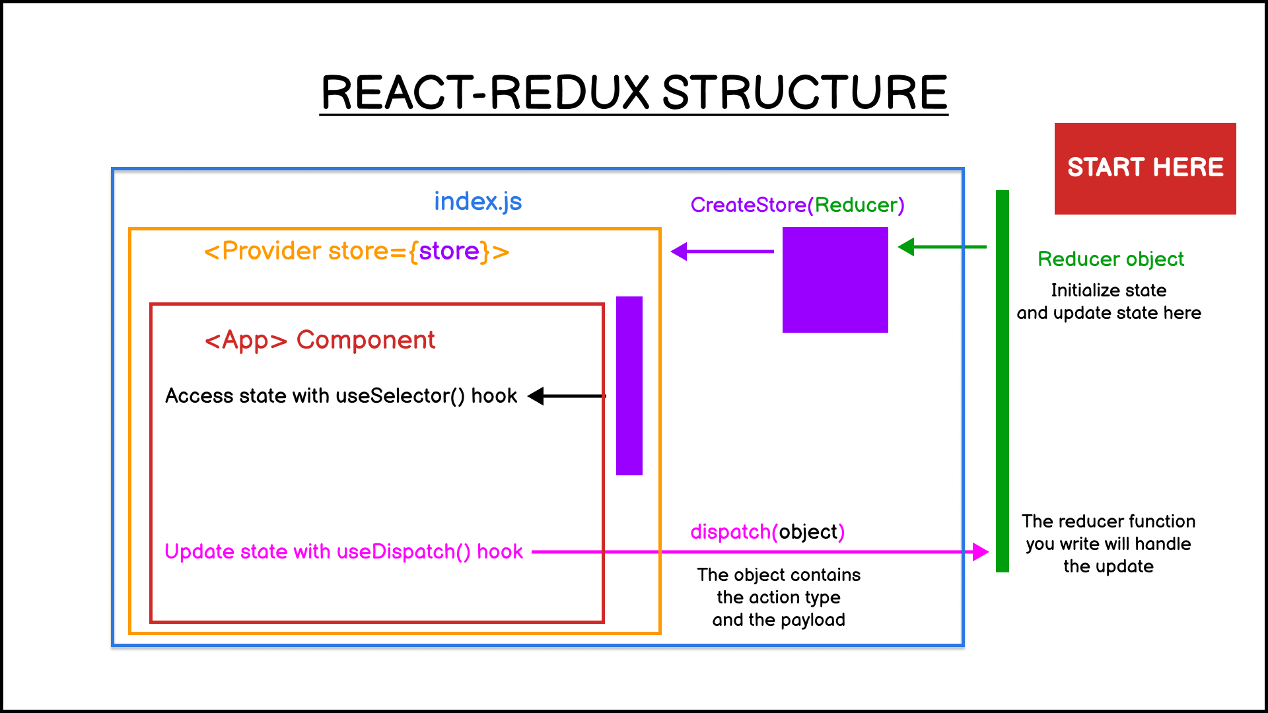

Slide 7
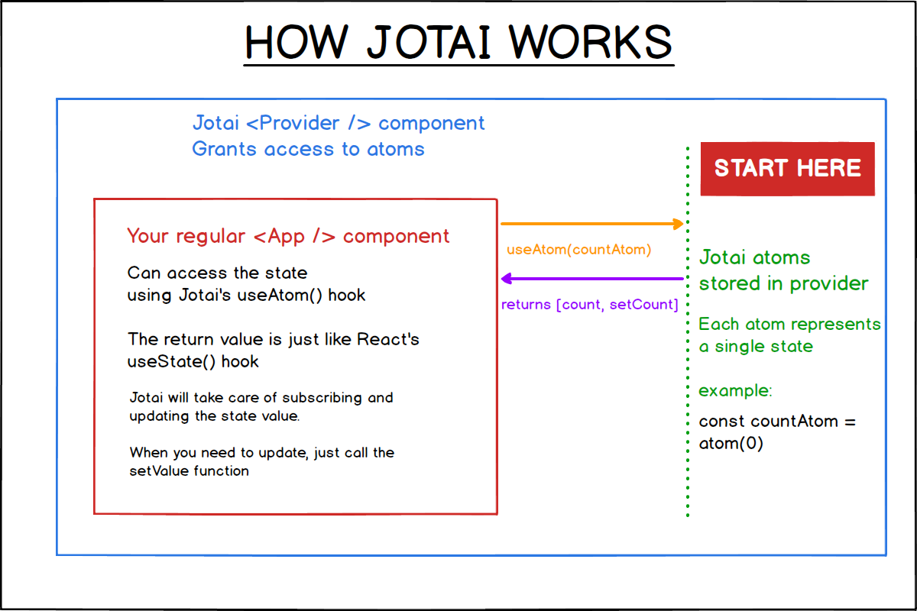

Slide 8
 | Redux | Jotai
Installing | npm install redux Or yarn install redux And npm install react-redux Or yarn install react-redux | npm install jotai Or yarn install jotai

Slide 9
Generally, the first place to refactor is to replace your Redux Provider with Jotai Provider.
From this:
import { createStore } from "redux"; import { Provider } from "react-redux"; import App from "./App";
const store = createStore(reducer);
const Main = () => ( <Provider store={store}> <App /> </Provider> )
Into this:
import { Provider } from "jotai"; import App from "./App";
const Main = () => ( <Provider> <App /> </Provider> )

Slide 10
There’s no longer any need to pass store into the Provider, but you do need to create atoms to replace the store mechanism. If you have a defaultState applied to your reducer, you can use it as a reference to create your atoms:
const defaultState = { isPrimary: true, };
const reducer = (state = defaultState, action) => { // rest of the code omitted... }
The reducer above can be replaced with a simple atom function:
import { atom } from "jotai";
export const isPrimaryAtom = atom(true)

Slide 11
Now that you have the Provider and the Store part refactored, you only need to replace your Dispatcher and Action to complete the refactor. The general pattern of the Dispatcher should look like this:
import { useSelector, useDispatch } from "react-redux";
function App() { const isPrimary = useSelector((state) => state.isPrimary); const dispatch = useDispatch();
const title = isPrimary ? "Primary" : "Secondary";
return ( <StyledButton isPrimary={isPrimary} onClick={() => { dispatch({ type: "TOOGLE_BUTTON", payload: !isPrimary }); }}
/> );

Slide 12
You need to replace the import with Jotai’s useAtom and use the returned state updater to replace your Dispatcher:
import { useAtom } from "jotai"; import { isPrimaryAtom } from "./Atoms";
function App() {
const [isPrimary, setIsPrimary] = useAtom(isPrimaryAtom);
const title = isPrimary ? "Primary" : "Secondary";
return ( <StyledButton isPrimary={isPrimary} onClick={() => { setIsPrimary(!isPrimary); }}
/> );

